Slide 1
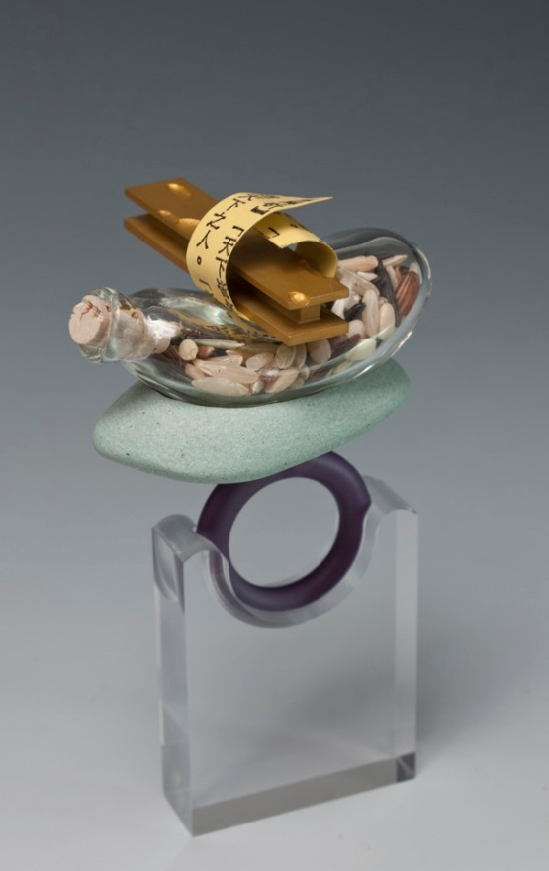
Example 2
a ring
“Look beyond the adjectives”
Ring 2013
Anodized aluminum, wild rice, Pyrex glass, brass, rock, cork, acrylic paint, Plexiglas, and laser printer ink.
2.25”(L) x 1.75” (W) x 2.75” (H)
Glass bottle credit: Benjamin Revis
Notes:
“Look beyond the adjectives”
(形容詞的紊亂). When ever there are differences, people start to compare: you are too fat, too thin, too tall, too short… and discriminations begin. / I live in both Hong Kong and US, and I have seen and experienced discriminations. / Discrimination happens in every country and society. It comes in many forms. / Inside the glass bottle are many different kind of grains. We should look beyond their differences on the surfaces, and recognize the contribution each makes.

Slide 2
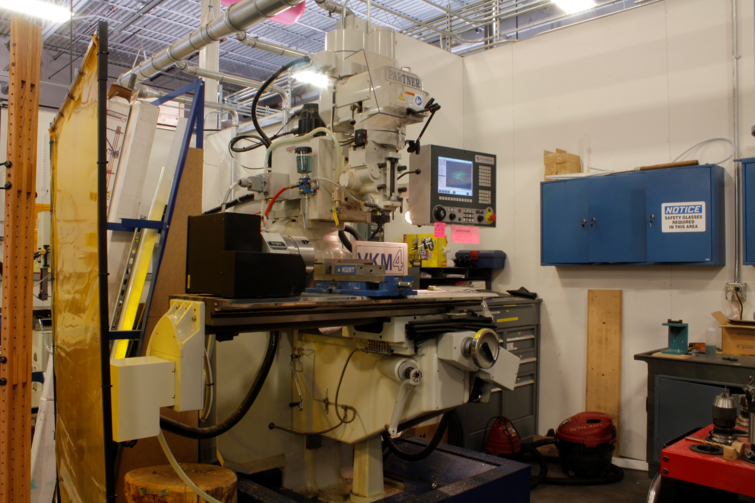
I use the Miltronics 7200 milling machine to make the ring band.

Slide 3
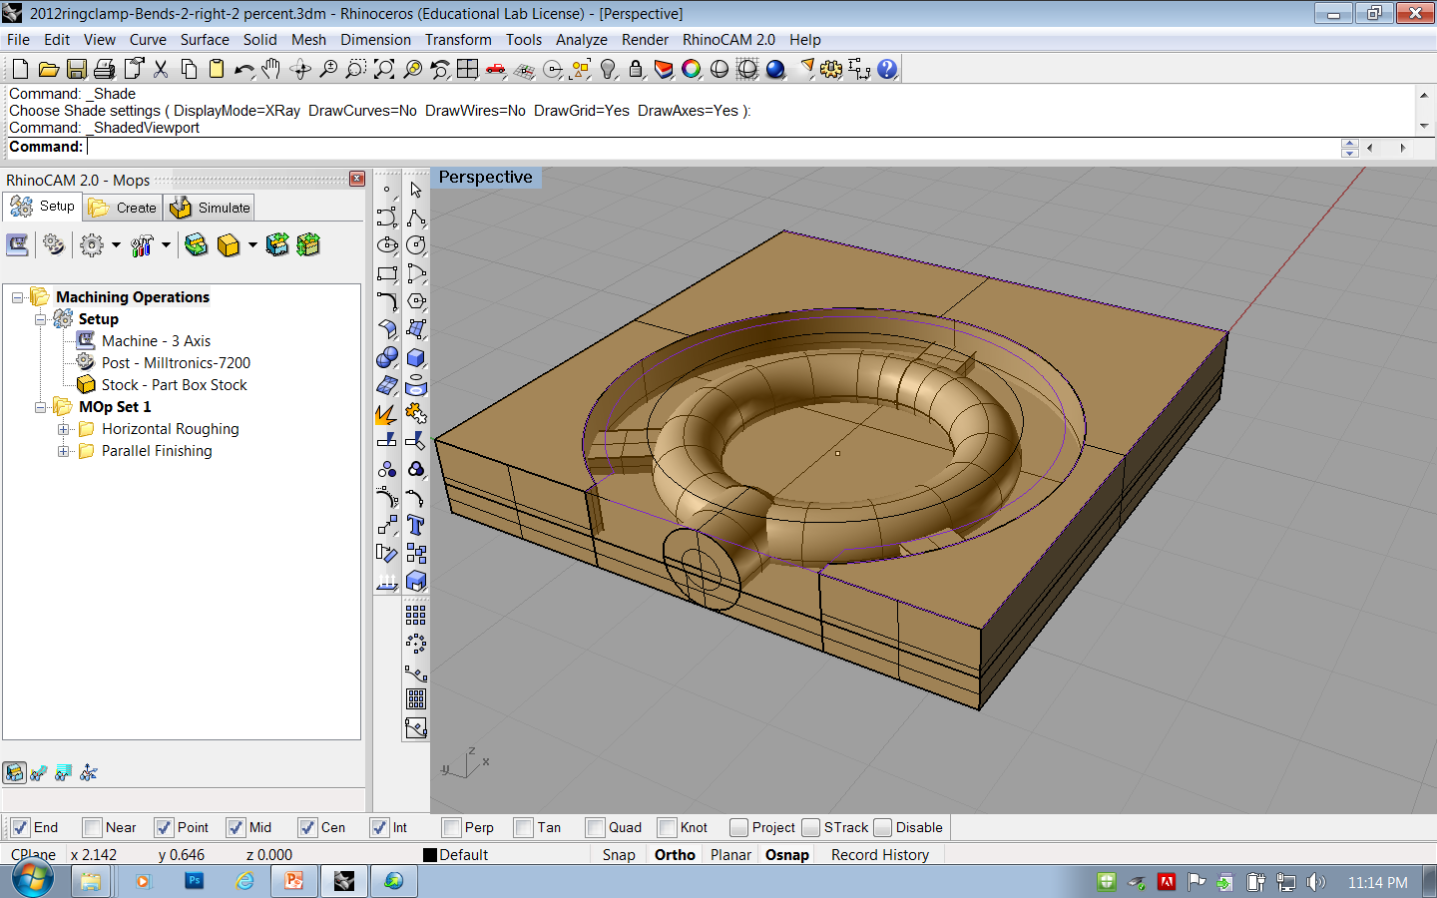
I draw the ring band digital design and generate the g-code with Rhinoceros. 3D software.

Slide 4
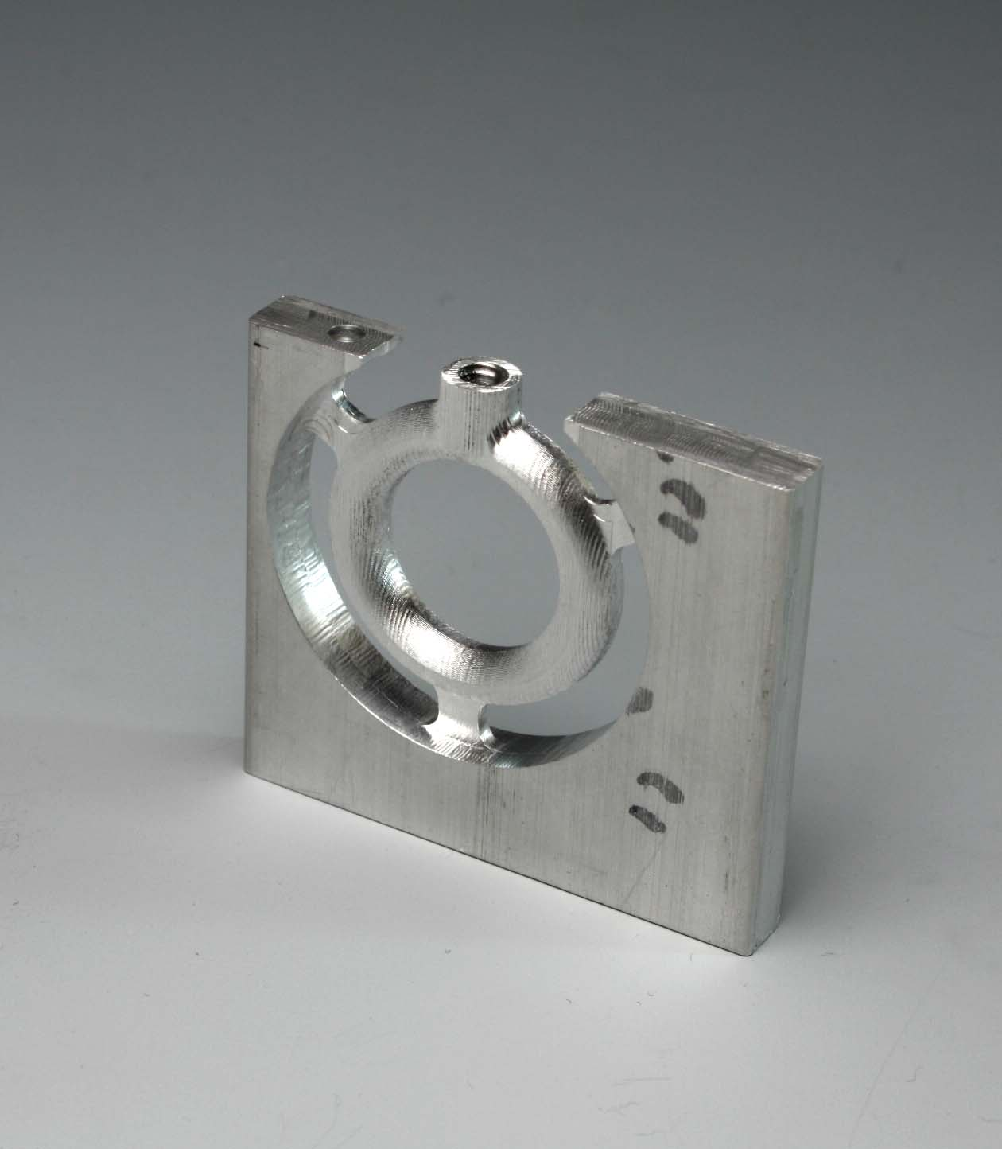
0.25” thick 6061 aluminum
Drilled and taped
The ring band need to be milled from both sides
The three tabs support the ring band and prevent it from becoming dislodged during milling.

Slide 5
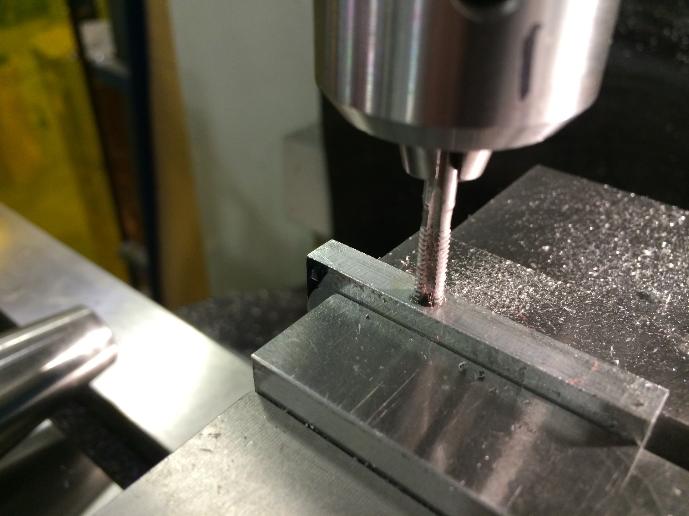
The stock was first drilled and taped, so that other elements could be screwed to the ring band later.

Slide 6
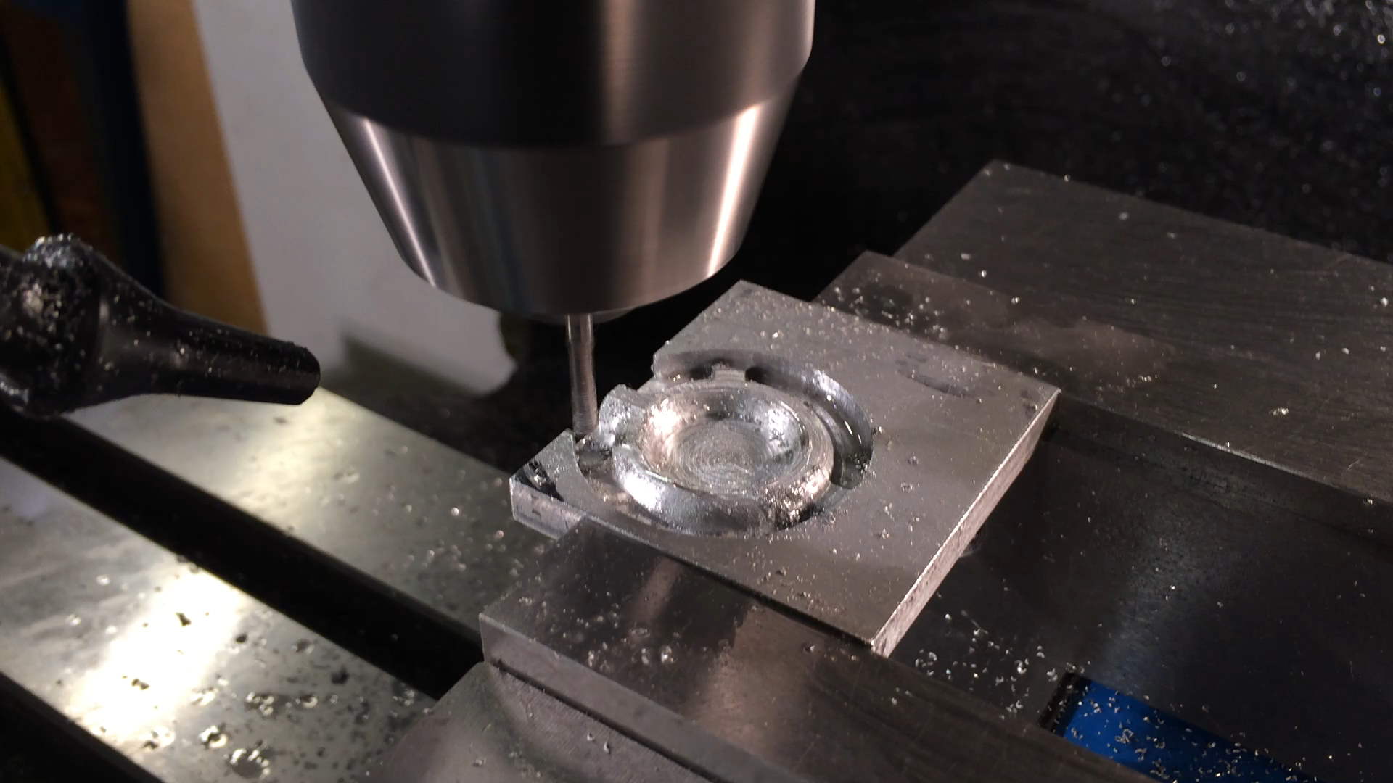
Video of milling
Click to start.
Milling on the first side.

Slide 7
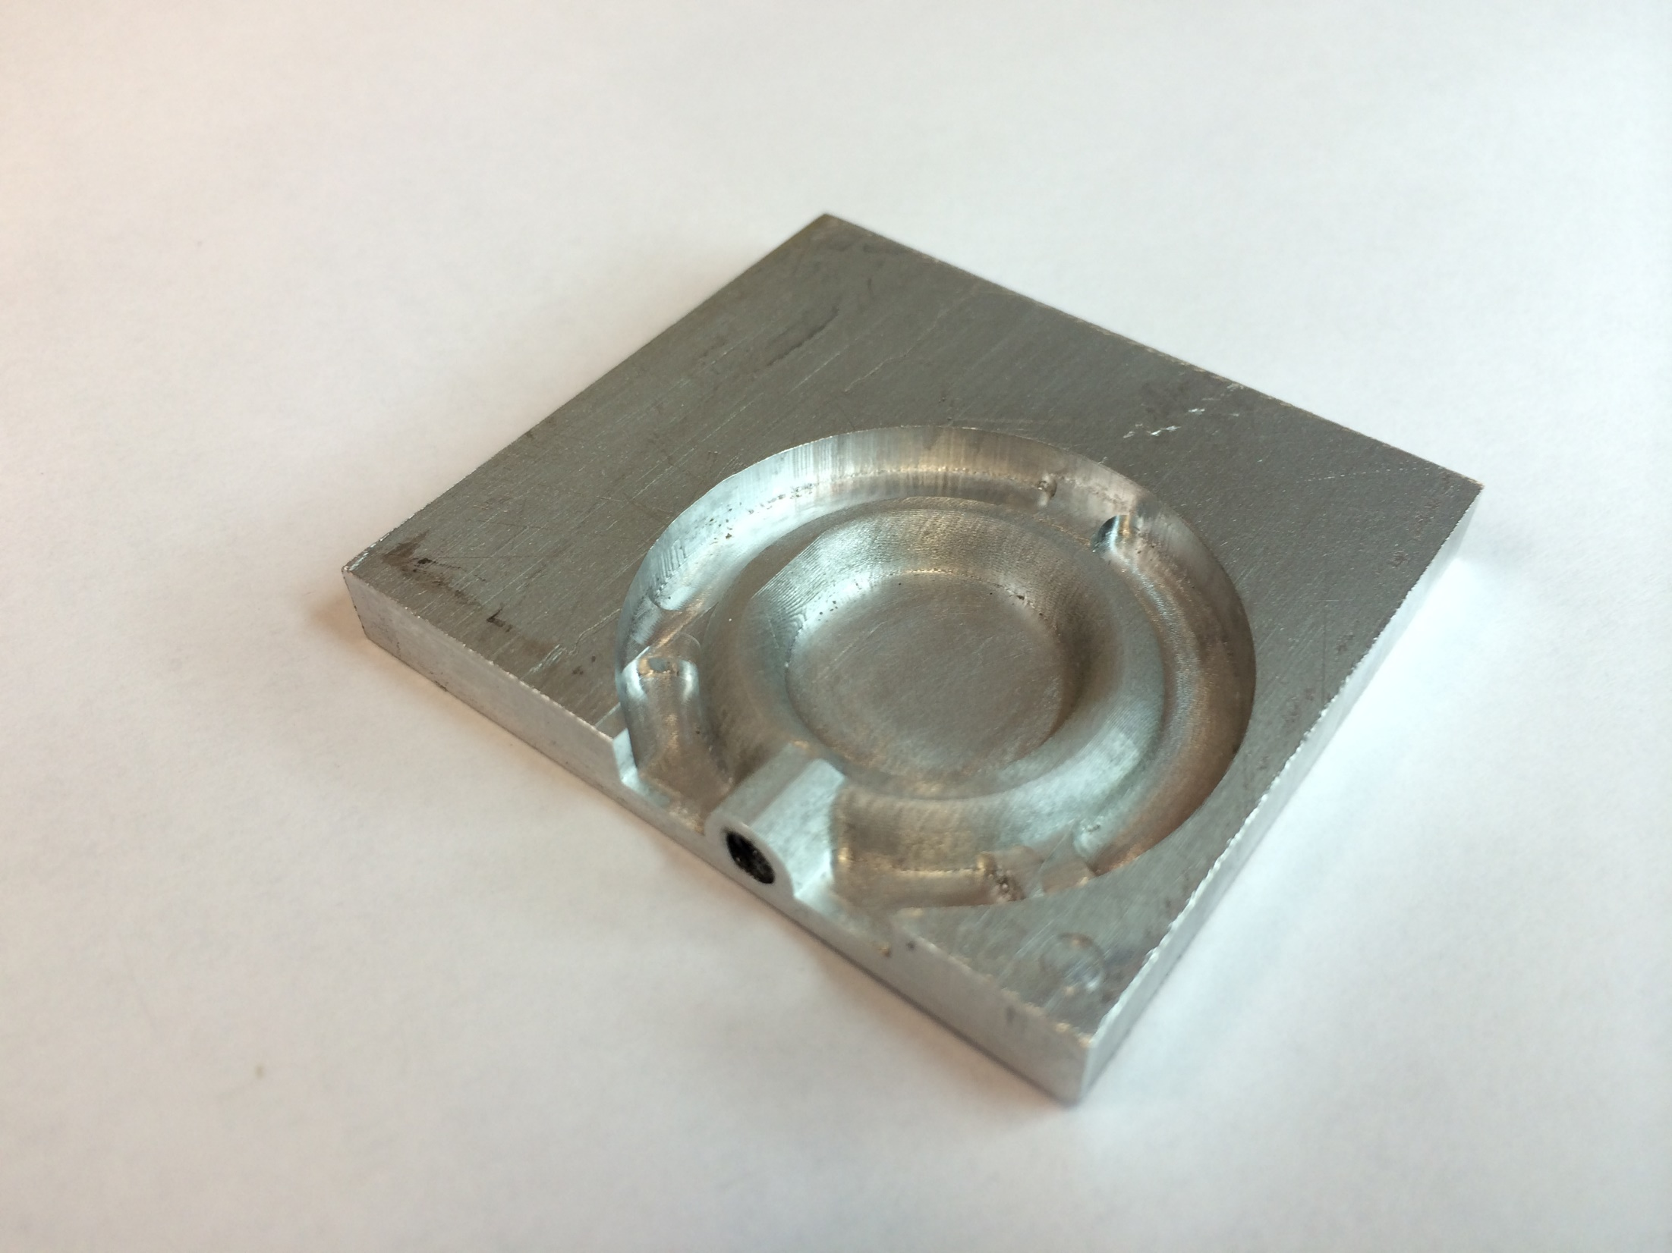
First half of the ring band finished milling

Slide 8
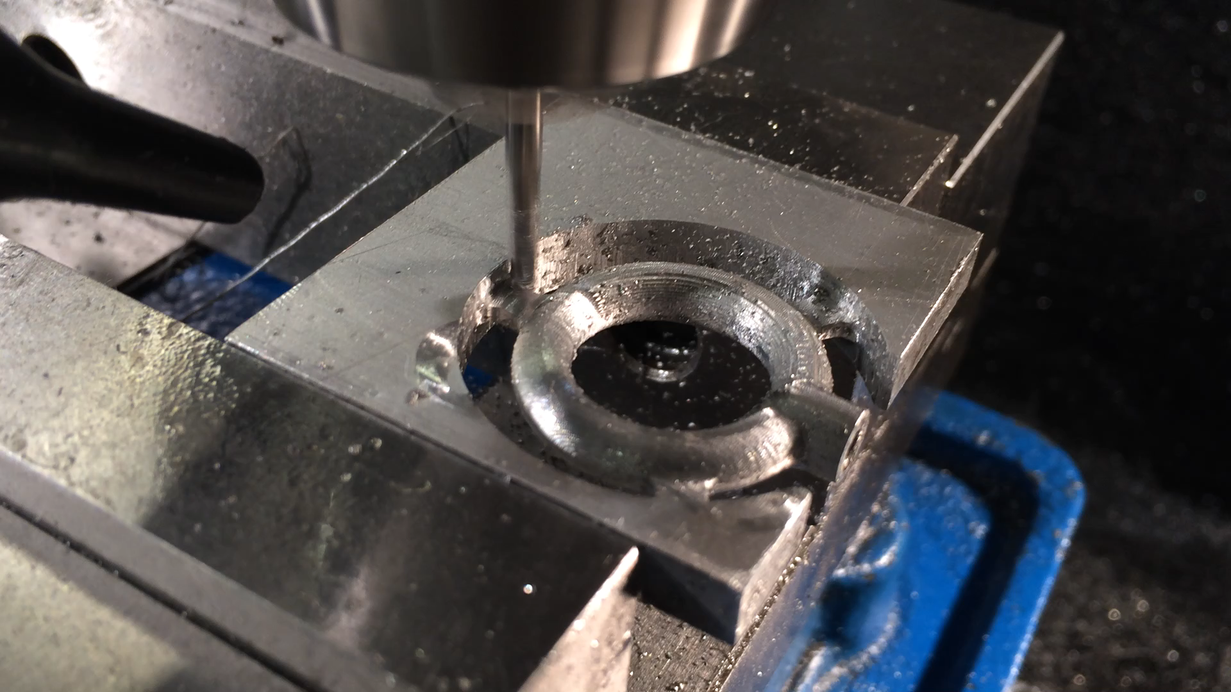
Video of milling
Click to start.
Flip over and mill the second half.

Slide 9
0.25” thick 6061 aluminum
Drilled and taped
Finished milling the ring band, next to follow with filing, polishing, and anodization.

Slide 10
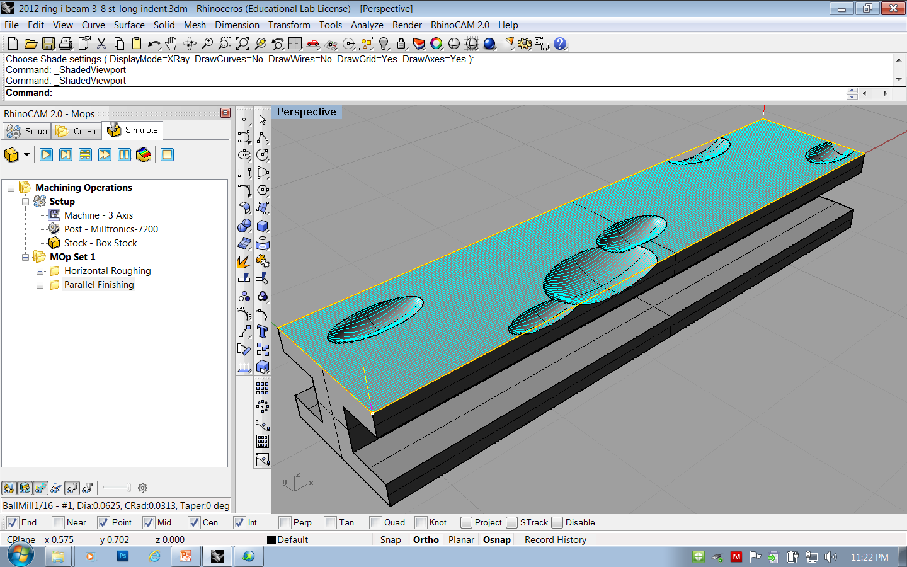
Milling and finishing the I-beam is the same as the ring band.

Slide 11
“Look beyond the adjectives”
Ring 2013
Anodized aluminum, wild rice, Pyrex glass, brass, rock, cork, acrylic paint, Plexiglas, and laser printer ink.
2.25”(L) x 1.75” (W) x 2.75” (H)
Glass bottle credit: Benjamin Revis
Notes:
“Look beyond the adjectives”
(形容詞的紊亂). When ever there are differences, people start to compare: you are too fat, too thin, too tall, too short… and discriminations begin. / I live in both Hong Kong and US, and I have seen and experienced discriminations. / Discrimination happens in every country and society. It comes in many forms. / Inside the glass bottle are many different kind of grains. We should look beyond their differences on the surfaces, and recognize the contribution each makes.

